Slide 1


Lander Laparra
2025/06/26

Slide 2

Outline
Executive Summary
Introduction
Methodology
Results
Conclusion
Appendix

Slide 3
Executive Summary
Summary of Methodologies:
Data Collection: The dataset for SpaceX launches was collected using a combination of API calls and web scraping techniques. This data includes detailed information about launch sites, payload mass, orbit type, launch outcomes, and rocket specifications.
Data Cleaning: Data preprocessing was performed to handle missing values, remove irrelevant records, and filter the dataset to focus solely on Falcon 9 launches. Missing payload mass values were imputed with the mean, and categorical variables were standardized using one-hot encoding.
Exploratory Data Analysis (EDA): EDA was conducted to understand relationships between key variables such as payload mass, launch site, and landing success. Visualizations such as histograms, scatter plots, and interactive maps created with Folium were used to analyze the proximity of launch sites and landing success.
Predictive Modeling: Various machine learning models, including Logistic Regression, SVM, Decision Trees, and K-Nearest Neighbors (KNN), were used to predict landing success. Hyperparameters for these models were optimized using GridSearchCV, and model performance was evaluated based on accuracy, precision, and recall.
SQL Queries: SQL was employed to perform advanced data extraction and aggregation, answering critical questions such as the success rate of landings at each launch site.

Slide 4
Executive Summary
Summary of All Results:
Key Findings:
Launch Site: The analysis revealed that the success rate of Falcon 9 landings varied across different sites. For example, KSC LC 39A and VAFB SLC 4E showed a success rate of approximately 77%, whereas CCAFS LC-40 had a lower success rate of 60%.
Payload Mass: A payload mass greater than 10,000 kg at CCAFS LC-40 was associated with a 100% success rate in landings.
Best Model: The Support Vector Machine (SVM) with a linear kernel provided the best results for predicting landing success. It outperformed other models in terms of accuracy.
Prediction Accuracy: The Logistic Regression model achieved reliable performance, showing high accuracy and precision in predicting landing outcomes (success or failure).
SQL Analysis: SQL queries were used to uncover key trends, such as the number of successful landings at each launch site and the relationship between landing outcomes and orbit types. It was found that ISS orbit had a higher success rate for landings.
Interactive Analysis: Folium maps were utilized to visualize the geographical locations of the launch sites and their proximities. These maps revealed patterns in the distribution of launch sites and success rates.

Slide 5
Introduction
Project Background and Context:
SpaceX has revolutionized the space industry with its ability to reuse rocket components, specifically the Falcon 9's first stage. Reusing the first stage significantly reduces the cost of launches, making space exploration more affordable. However, predicting the likelihood of successful landings is still a challenge. The goal of this project is to develop a predictive model that can forecast whether the first stage of a Falcon 9 rocket will land successfully.
This analysis is crucial not only for optimizing costs but also for improving the efficiency and reliability of rocket launches. By analyzing past launches and identifying patterns, SpaceX can refine its operations and make more informed decisions about future missions.

Slide 6
Introduction
Problems to Find Answers:
What factors influence the success or failure of Falcon 9 landings?
Does the launch site impact landing success?
How does payload mass affect landing outcomes?
Can we predict the likelihood of a successful landing?
Can machine learning models, such as Logistic Regression, SVM, and Decision Trees, accurately predict landing success based on various features?
Which machine learning model performs the best for predicting landing success?
How can we optimize model hyperparameters to achieve the highest accuracy?
How do geographical factors play a role in landing success?
Can we identify geographical patterns using maps to determine optimal landing sites?

Slide 7

Section 1

Slide 8
Methodology
Executive Summary
Data collection methodology:
Describe how data was collected
Perform data wrangling
Describe how data was processed
Perform exploratory data analysis (EDA) using visualization and SQL
Perform interactive visual analytics using Folium and Plotly Dash
Perform predictive analysis using classification models
How to build, tune, evaluate classification models

Slide 9
Data Collection
Data Collection Process:
API Data Collection: The launch data was collected using the SpaceX API. The data included information such as the launch site, payload mass, orbit type, landing outcomes, and rocket details (e.g., rocket type, booster version).
API Endpoint: Data was pulled from the SpaceX API's launch data endpoint.
Web Scraping: Web scraping was employed to gather additional data from Wikipedia. We specifically targeted the list of SpaceX Falcon 9 and Falcon Heavy launches for more detailed records on landing outcomes and launch specifics.
Scraping Method: BeautifulSoup and requests were used for extracting tables from the web page.
Database Queries (SQL): A SQL database was used to filter and aggregate launch data. We performed complex SQL queries to analyze trends, such as the number of successful landings per site or payload mass distribution.

Slide 10
Data Collection
Key Points:
Data Sources: SpaceX API, Web Scraping, SQL Database.
Tools Used: Python (requests, BeautifulSoup, pandas, SQLAlchemy), PowerBI (for visualizations).
Data Sources Outcome: Detailed launch data including both successful and failed landings.

Slide 11
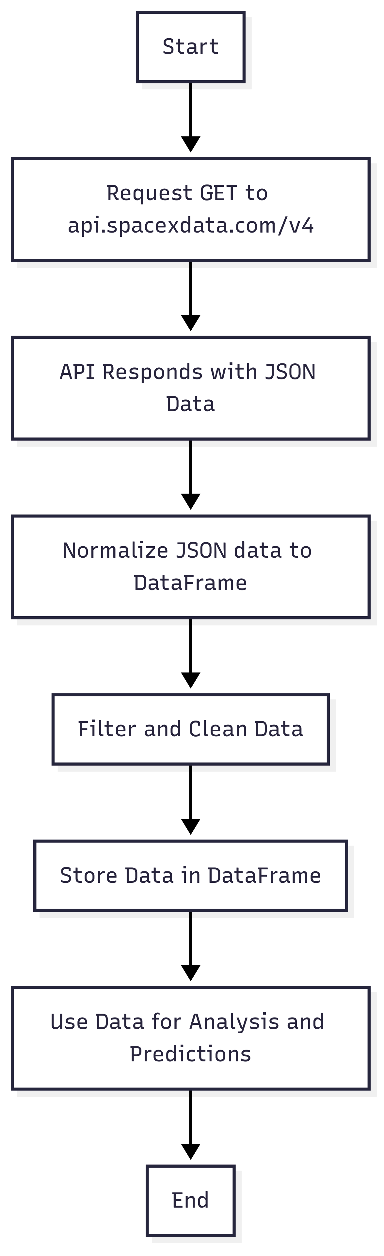
Data Collection – SpaceX API
Notebook Link

Slide 12
Data Collection – SpaceX API
API Endpoints:
Request to SpaceX Launches (Past Data):
Endpoint: /v4/launches/past
Purpose: This endpoint is used to pull historical SpaceX launches data including information like the launch site, payload mass, orbit type, landing outcomes, and rocket details.
Request to SpaceX Rocket Data:
Endpoint: /v4/rockets/{rocket_id}
Purpose: To gather detailed information about the rocket (booster version) used in each launch.
Request to SpaceX Launchpad Data:
Endpoint: /v4/launchpads/{launchpad_id}
Purpose: To get information about the launch site location, including longitude, latitude, and name.
Request to SpaceX Payload Data:
Endpoint: /v4/payloads/{payload_id}
Purpose: To collect details about the payload (payload mass, orbit type).
Request to SpaceX Core Data:
Endpoint: /v4/cores/{core_id}
Purpose: To retrieve data about the core, including landing success, type of landing, number of flights, and whether the core was reused.

Slide 13
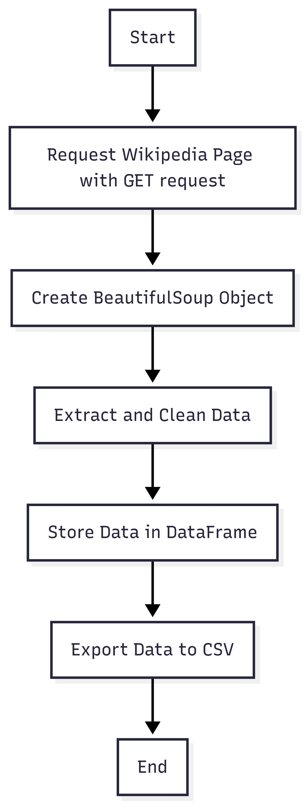
Data Collection - Scraping
Notebook Link
Key Steps:
HTTP GET Request to Wikipedia page using requests.
Parse the page using BeautifulSoup.
Extract, clean, and process the table rows and columns.
Store the clean data in a Pandas DataFrame.
Export the DataFrame to a CSV file.

Slide 14
Data Wrangling
Notebook Link

Slide 15
Data Wrangling
Handling Missing Data:
The missing values in the payload mass column were replaced with the mean value for consistency.
For other missing data, such as in the launch site or customer columns, appropriate handling was applied (e.g., replacing None with specific categories or values).
Filtering Irrelevant Records:
Non-Falcon 9 launches were filtered out to focus on the relevant dataset.
Records with inconsistent or incomplete data were either cleaned or removed as necessary.
Converting Data Types:
Categorical variables, such as launch sites and orbit types, were encoded using one-hot encoding to prepare them for analysis and machine learning.
Numeric data, including payload mass and flight numbers, were ensured to be in the correct data type (e.g., float64, int64).
Handling Outliers and Irregular Data:
Outliers in the payload mass column were identified and handled accordingly (e.g., trimming or capping).
Training Labels:
Landing outcomes were transformed into binary labels where 1 represents a successful landing and 0 represents a failed landing.

Slide 16
EDA with Data Visualization
Notebook Link
Charts Plotted:
Flight Number vs Launch Site: Scatter plot showing no clear relationship between flight number and launch site success.
Payload Mass vs Launch Site: Scatter plot revealing heavy payloads are launched from CCAFS SLC 40.
Success Rate by Orbit Type: Bar chart highlighting ISS orbit as the highest success rate, with GTO lower.
Flight Number vs Orbit Type: Scatter plot showing success rate related to flight number, particularly for LEO.
Payload Mass vs Orbit Type: Scatter plot identifying heavy payloads in Polar, LEO, and ISS orbits.
Launch Success Rate Over Years: Line plot showing increasing success rate from 2013 to 2020.

Slide 17
EDA with SQL
Notebook Link
SQL Queries Performed:
Count of Successful Landings Per Launch Site: Calculated the number of successful launches per site to analyze patterns in landing success across different locations.
Landing Success Rate by Payload Mass: Investigated if payload mass correlates with landing success using aggregate SQL queries to group by payload mass and calculate success rates.
Average Payload Mass by Launch Site: Aggregated data to calculate the average payload mass for each launch site, providing insights into payload characteristics by site.
Filter Data for Successful Launches: Used SQL WHERE clauses to filter records for successful landings, focusing the analysis only on successful missions.
Identify Key Trends in Landing Outcomes: Analyzed trends in landing outcomes, including identifying landing success rates across different orbit types.

Slide 18
Build an Interactive Map with Folium
Notebook Link
Map Objects Created:
Markers:
Added markers for each launch site to represent the geographic location of SpaceX launch sites on the map.
Each marker is interactive, displaying relevant information when clicked, such as the site name and its geographical coordinates.
Circles:
Used circles to highlight launch site locations with a radius proportional to the number of launches at each site.
This visually indicates the density of launches per site, helping to emphasize the importance of more frequently used sites.
Lines:
Drawn lines between key launch sites to show proximity and provide spatial relationships between different sites.
This was done to visualize the proximity of launch sites in relation to each other, especially for geographical analysis.

Slide 19
Build an Interactive Map with Folium
Reason for Adding Map Objects:
Markers allow users to visually pinpoint launch sites on the map and interact with them for detailed information.
Circles help to quickly assess which launch sites are used more frequently, providing a visual cue about site activity.
Lines aid in understanding the spatial relationships between launch sites, enhancing geographical context.

Slide 20
Build a Dashboard with Plotly Dash
Dash Source Link
Overview of the Dashboard Features:
Dropdown Selector: Allows dynamic filtering by launch site, enabling focused analysis on specific locations or aggregated view.
Range Slider: Enables users to interactively filter payload mass (0–10,000 kg) to explore its effect on success rate.
Pie Chart: Visualizes success vs failure counts, adapting dynamically to the selected site.
Scatter Plot: Shows the correlation between payload mass and mission outcome, color-coded by booster version category.
Purpose & Insights:
These interactive elements help users explore launch patterns, identify high-performing sites (e.g., CCAFS LC-40), and observe success trends across different payload ranges and booster versions.

Slide 21
Predictive Analysis (Classification)
Notebook Link
Model Development Summary:
Data Preparation:
Features selected: Payload Mass, Orbit, Launch Site, GridFins, Reused, Legs, etc.
Applied one-hot encoding to categorical variables and normalization to numeric features.
Model Building:
Trained and evaluated:
Logistic Regression
SVM
Decision Tree
K-Nearest Neighbors
Model Evaluation:
Accuracy measured for each model using a train-test split.
Logistic Regression achieved the highest baseline performance.
Hyperparameter Tuning:
GridSearchCV used to fine-tune hyperparameters of all models.
Final comparison showed Logistic Regression as the best performing model.
Result:
Best model: Logistic Regression
Final accuracy: 0.8333.

Slide 22
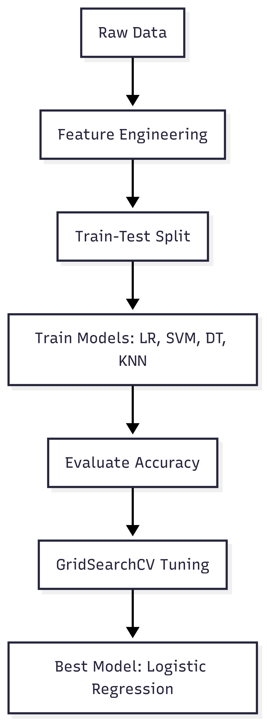
Predictive Analysis (Classification)

Slide 23
Results
Exploratory Data Analysis (EDA):
Launch success rate is correlated with both payload mass and orbit type.
Certain launch sites (e.g., KSC LC 39A) show higher success rates.
Success rates increased steadily over time, reaching over 90% by 2019–2020.
Orbits like SSO, HEO, and ES-L1 had near-perfect success.
Interactive Analytics (Dashboard):
Dropdowns and sliders allow filtering by launch site and payload range.
Pie charts summarize success vs failure counts interactively.
Scatter plots show correlation between payload and success per orbit/site.
Enables dynamic, real-time insights for business and technical audiences.
Predictive Analysis:
Logistic Regression selected as best model with accuracy = 0.8333.
Models trained: Logistic Regression, SVM, Decision Tree, KNN.
Features used: Payload mass, Orbit, Launch site, Booster reuse indicators.
Data was preprocessed, encoded, scaled and fine-tuned using GridSearchCV

Slide 24

Section 2

Slide 25
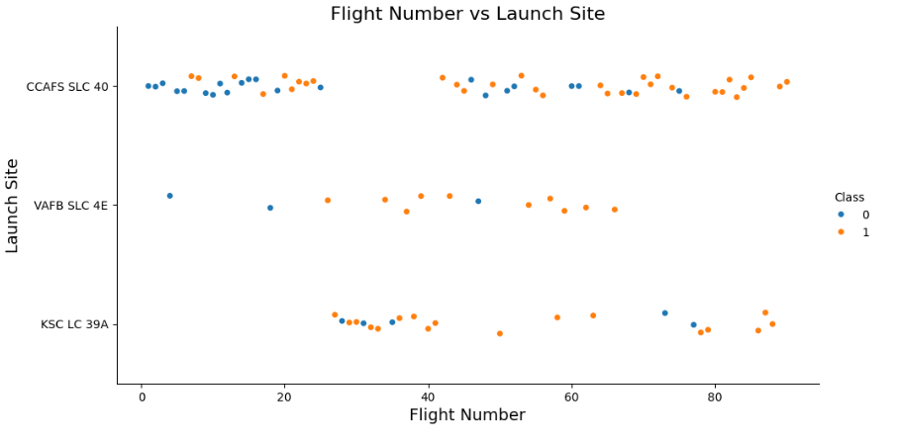
Flight Number vs. Launch Site
Objective: Analyze whether the number of flights (experience) affects launch success per site.
Visualization: Scatter plot of Flight Number vs. Launch Site, colored by success class (0 = Failure, 1 = Success).
Insights:
Launches at KSC LC 39A and VAFB SLC 4E show more consistent success rates in later flights.
CCAFS SLC 40 has a mix of failures and successes across many flight numbers.
There's a visible trend where higher flight numbers correlate with more successes, especially at KSC LC 39A.
Interpretation: Experience and infrastructure maturity (represented by higher flight numbers) contribute to better outcomes.

Slide 26
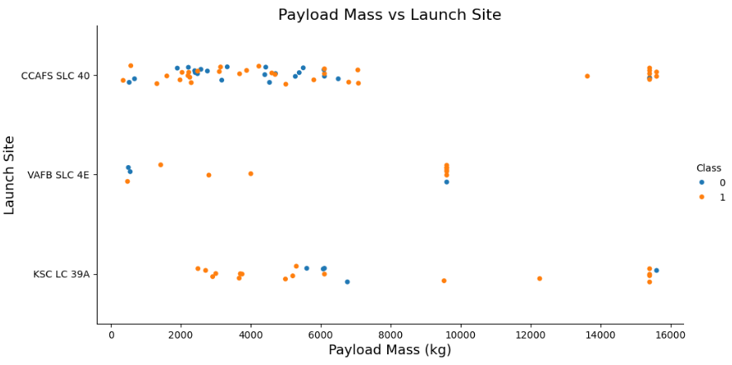
Payload vs. Launch Site
Objective: Explore whether the payload mass influences the outcome depending on the launch site.
Visualization: Scatter plot of Payload Mass (kg) vs. Launch Site, colored by class (0 = Failure, 1 = Success).
Insights:
VAFB SLC 4E has no launches with payloads above 10,000 kg.
Both CCAFS SLC 40 and KSC LC 39A supported heavy payloads.
Successful landings are more prevalent for moderate payloads across sites.
Interpretation: Heavy payloads seem less frequent and more successful from advanced launch facilities like KSC LC 39A.

Slide 27
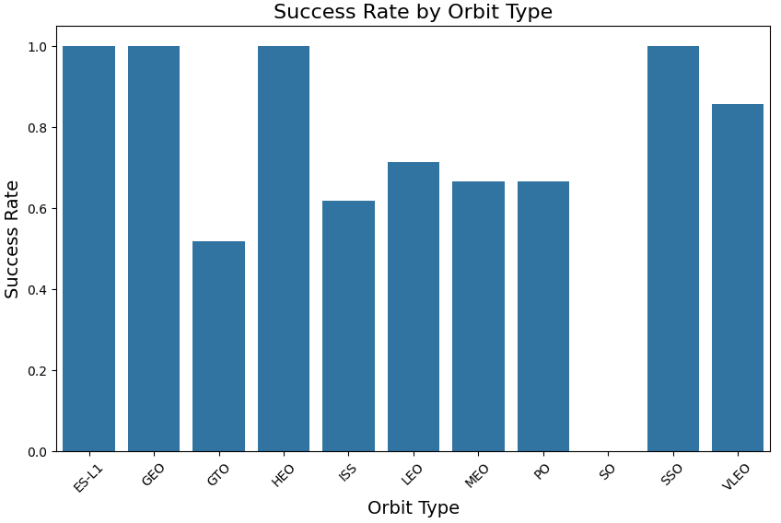
Success Rate vs. Orbit Type
Objective: Analyze how different orbit types relate to mission success rates.
Visualization: Bar chart showing the average Class (success rate) per Orbit.
Insights:
Highest success rates observed in orbits ES-L1, GEO, HEO, and SSO.
Orbits like GTO and ISS show comparatively lower success rates.
Some orbits (e.g., SO) show no successful missions.
Interpretation: The orbit type can influence mission complexity and landing success, with specialized orbits showing better reliability.

Slide 28
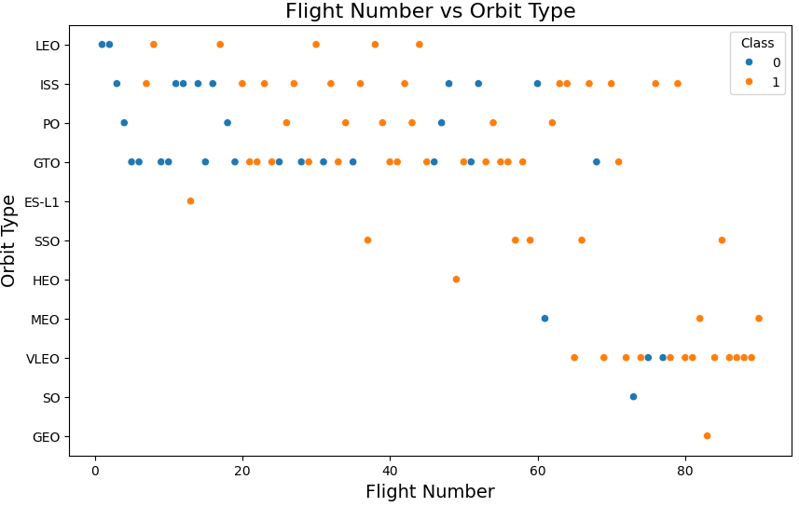
Flight Number vs. Orbit Type
Objective: Examine whether mission experience (flight number) influences success across orbit types.
Visualization: Scatter plot with Flight Number on the x-axis, Orbit on the y-axis, and Class as hue (success/failure).
Insights:
In LEO, success improves with flight number — possibly due to learning effects and process refinement.
In GTO, no clear relationship is observed between flight number and mission outcome.
Some orbits show limited data, making patterns inconclusive.
Interpretation: The impact of launch experience (flight number) varies across orbit types, indicating some missions are more sensitive to operational maturity.

Slide 29
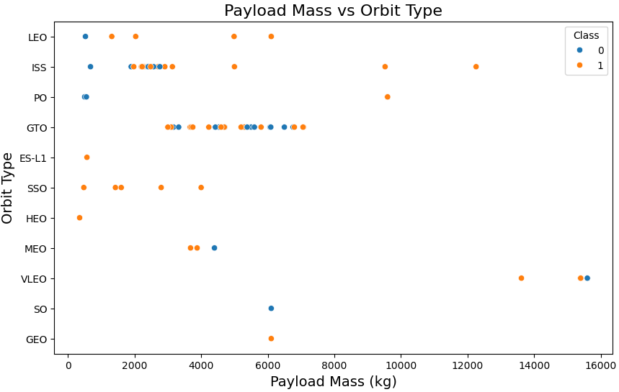
Payload vs. Orbit Type
Objective: Explore how payload mass influences success rates across different orbit types.
Visualization: Scatter plot with Payload Mass (kg) on the x-axis, Orbit Type on the y-axis, and Class (success/failure) as hue.
Insights:
Higher payloads to LEO, Polar, and ISS orbits tend to correlate with successful landings.
In GTO, both successful and unsuccessful landings are observed across payloads — no clear trend.
Several orbit types show consistent success regardless of payload weight.
Interpretation: Mission design and orbit type appear more predictive of outcome than payload mass alone in some orbits.

Slide 30
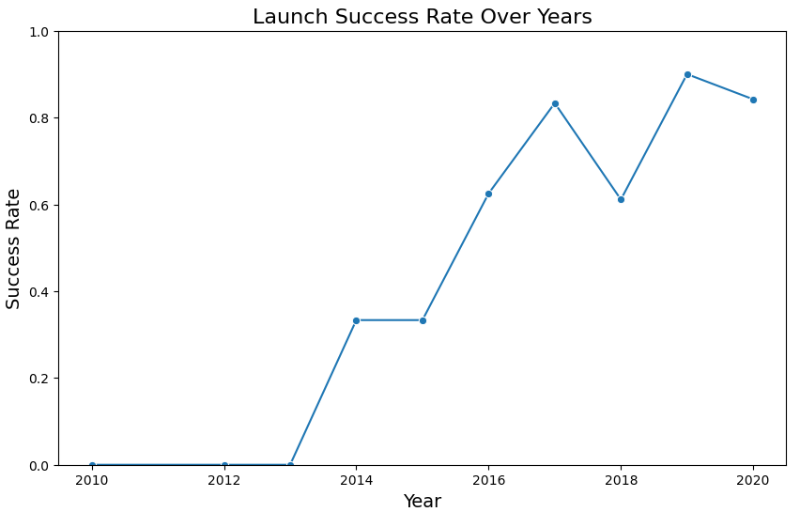
Launch Success Yearly Trend
Objective: Analyze the trend of launch success over time to assess improvements in SpaceX’s booster landing performance.
Visualization: A line chart was plotted to show the yearly average success rate, using the launch year on the x-axis and the mean of the Class label on the y-axis. This visualization highlights how SpaceX's success rate evolved over time.
Insights:
2010–2013: No successful landings recorded (success rate = 0).
2014–2017: Rapid growth in landing success.
2018: Slight dip, followed by continued improvements.
2019–2020: Consistently high performance, success rate near 0.9.
Interpretation: This trend demonstrates the increasing reliability of SpaceX’s landing technology. The sharp increase after 2014 aligns with the company's investment in reusable rocket stages, validating the effectiveness of iterative development and real-world testing.

Slide 31
All Launch Site Names
Query Executed
SELECT DISTINCT "Launch_Site" FROM SPACEXTBL;
Result
CCAFS LC-40
VAFB SLC-4E
KSC LC-39A
Explanation
The query retrieves distinct values from the Launch_Site column, identifying the three unique locations used by SpaceX for launches in this dataset. These results establish the basis for further site-specific performance analysis.

Slide 32
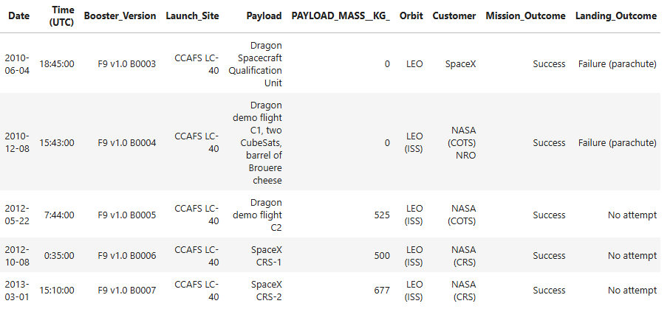
Launch Site Names Begin with 'CCA'
Query Executed
SELECT * FROM SPACEXTBL WHERE "Launch_Site" LIKE 'CCA%' LIMIT 5;
Result
Explanation
This query filters for launches from Cape Canaveral (CCAFS), a key SpaceX site. Reviewing these entries helps analyze patterns in payloads, mission types, and landing outcomes from this site.

Slide 33
Total Payload Mass
Query Executed
SELECT SUM("PAYLOAD_MASS__KG_") AS total_payload_mass FROM SPACEXTBL WHERE "Customer" = 'NASA (CRS)';
Result
Total Payload Mass: 45,596 kg
Explanation
This query calculates the cumulative payload mass delivered by SpaceX boosters under NASA’s Commercial Resupply Services (CRS) program. It highlights the significant logistical role of CRS missions in supporting the International Space Station.

Slide 34
Average Payload Mass by F9 v1.1
Query Executed
SELECT AVG("PAYLOAD_MASS__KG_") AS avg_payload_mass FROM SPACEXTBL WHERE "Booster_Version" = 'F9 v1.1';
Result
Average Payload Mass: 2,928.4 kg
Explanation
This query determines the average payload mass carried by Falcon 9 version 1.1 boosters. It provides insight into the typical cargo capacity of this specific rocket variant, useful for performance benchmarking.

Slide 35
First Successful Ground Landing Date
Query Executed
SELECT MIN("Date") AS first_successful_landing_date FROM SPACEXTBL WHERE "Landing_Outcome" = 'Success (ground pad)';
Result
Date: 2015-12-22
Explanation
This query retrieves the earliest date when a successful landing on a ground pad occurred. The result highlights a major milestone in SpaceX’s reusability efforts: the first successful Falcon 9 booster recovery on solid ground.

Slide 36
Successful Drone Ship Landing with Payload between 4000 and 6000
Query Executed
SELECT "Booster_Version" FROM SPACEXTBL WHERE "Landing_Outcome" = 'Success (drone ship)' AND "PAYLOAD_MASS__KG_" > 4000 AND "PAYLOAD_MASS__KG_" < 6000;
Result
F9 FT B1022
F9 FT B1026
F9 FT B1021.2
F9 FT B1031.2
Explanation
This query filtered for booster versions that successfully landed on a drone ship and carried payloads between 4000 and 6000 kg. The result identifies specific missions that achieved a balance between heavy payload delivery and recovery success on sea platforms.

Slide 37
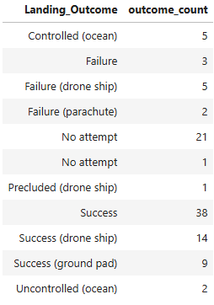
Total Number of Successful and Failure Mission Outcomes
Query Executed
SELECT "Landing_Outcome", COUNT(*) AS outcome_count FROM SPACEXTBL GROUP BY "Landing_Outcome";
Result Summary
Explanation
This query grouped all landing attempts by outcome and counted occurrences of each. It shows that out of the documented missions, 61 ended in successful landings and 10 resulted in failures. This breakdown highlights SpaceX's progress and growing reliability in booster recovery.

Slide 38
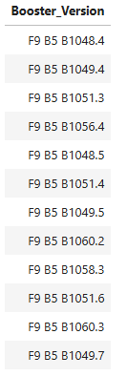
Boosters Carried Maximum Payload
Query Executed
SELECT "Booster_Version" FROM SPACEXTBL WHERE "PAYLOAD_MASS__KG_" = (SELECT MAX("PAYLOAD_MASS__KG_") FROM SPACEXTBL);
Result Summary
Explanation
This subquery identifies the highest payload mass in the entire dataset and then filters the boosters that achieved this value. The result highlights a cluster of F9 B5 series boosters, demonstrating their enhanced payload capacity compared to earlier versions.
Multiple entries match the maximum value due to repeated use of the same payload mass across different flights or boosters.

Slide 39
2015 Launch Records
Query Executed
SELECT CASE strftime('%m', "Date") WHEN '01' THEN 'January'... END AS "Month", "Landing_Outcome", "Booster_Version", "Launch_Site" FROM SPACEXTBL WHERE "Landing_Outcome" = 'Failure (drone ship)'AND strftime('%Y', "Date") = '2015';
Result Summary
The query retrieved 2 failed drone ship landings in 2015, specifically in January and April.
Both launches occurred at CCAFS LC-40.
The booster versions involved were F9 v1.1 B1012 and F9 v1.1 B1015.
Explanation
This query demonstrates how time-based filtering and pattern matching help isolate mission failures by month, which is crucial for identifying temporal patterns or issues in recovery processes.

Slide 40
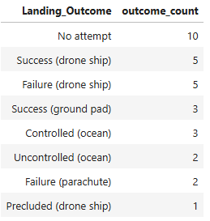
Rank Landing Outcomes Between 2010-06-04 and 2017-03-20
Query Summary
SELECT "Landing_Outcome", COUNT(*) AS outcome_count FROM SPACEXTBL WHERE "Date" BETWEEN '2010-06-04' AND '2017-03-20' GROUP BY "Landing_Outcome" ORDER BY outcome_count DESC;
Result Summary
Explanation
This query ranks the different types of landing outcomes to evaluate the frequency of successful recoveries versus other landing events. It reveals early trends in recovery strategy and operational maturity before 2017.

Slide 41

Section 3

Slide 42
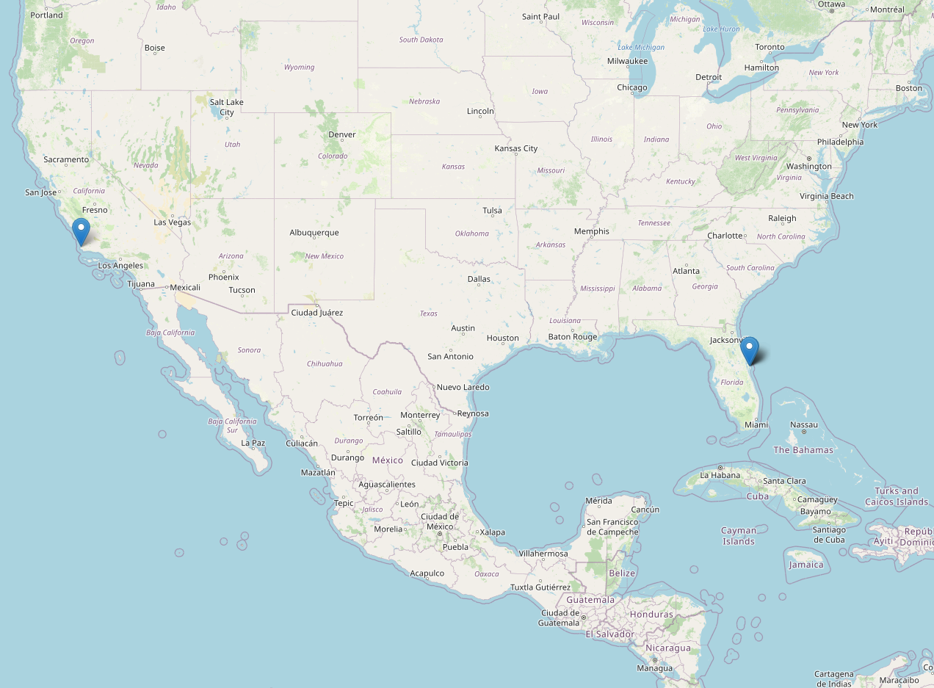
All Launch Sites - Global Geolocation
The screenshot displays a Folium-generated interactive map that marks all SpaceX launch site locations across the United States.
Key Elements
Blue location markers identify launch sites.
Sites are clustered along the U.S. coastlines: one on the West Coast (VAFB SLC-4E, California) and multiple on the East Coast (KSC LC-39A and CCAFS LC-40, Florida).
Zoom level adjusted to show continental context, highlighting how launch site geography may affect mission planning and logistics.
Findings
The East Coast is more densely populated with active launch sites, reflecting its logistical and orbital advantages (e.g., proximity to equator for geostationary launches).
The geographic spread supports diverse launch trajectories and recovery operations, which are critical for reusable rockets.

Slide 43
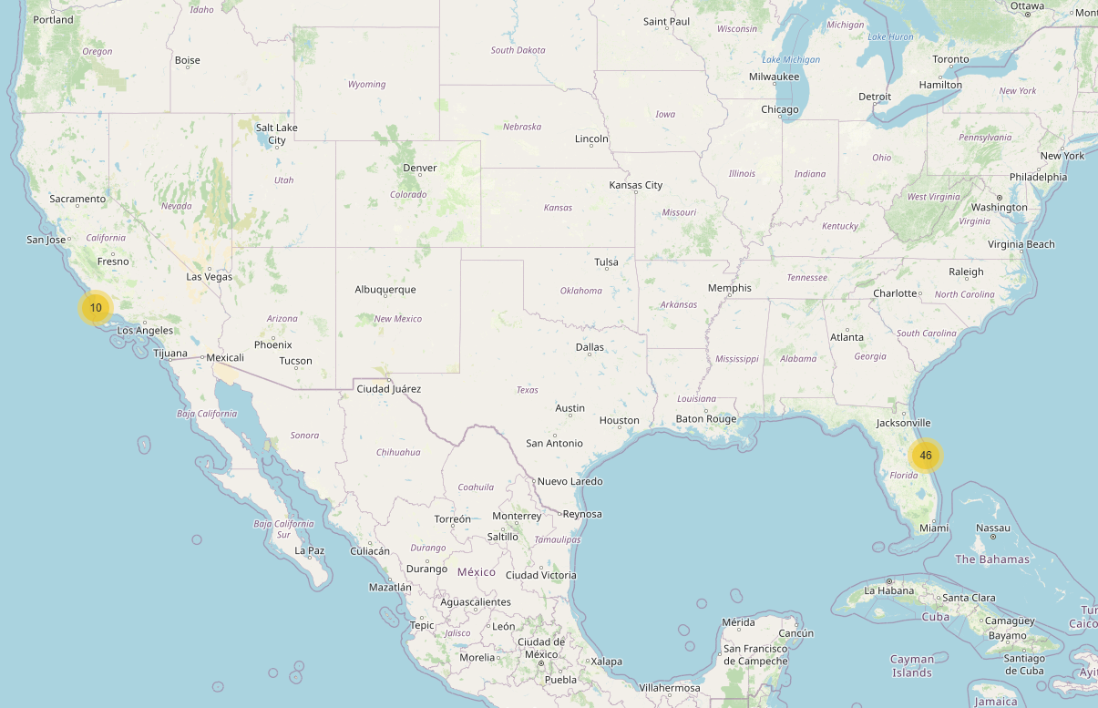
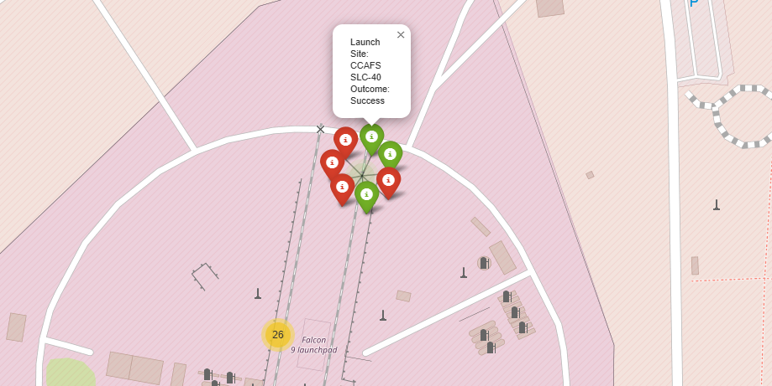
Launch Outcomes by Color
Objective: Visualize the outcome of Falcon 9 booster landings across different launch sites using color-coded markers.
Visualization: A Folium map is generated with clustered markers representing individual launch events. Each marker’s color reflects the outcome of the landing:
🟢 Green for successful landings
🔴 Red for failures
🟡 Yellow for no attempt or unknown outcome
Insights:
The map clearly shows that the majority of launches occurred in Florida (CCAFS and KSC).
Most successful landings are concentrated at specific sites, particularly KSC LC-39A.
California’s VAFB site appears to have fewer launch attempts, and a mix of outcomes.
Interpretation: The spatial distribution of landing outcomes reveals that SpaceX's reliability has improved over time at its main operational sites, with a high cluster of green markers indicating success. This visual summary supports temporal and spatial pattern analysis in SpaceX operations.

Slide 44
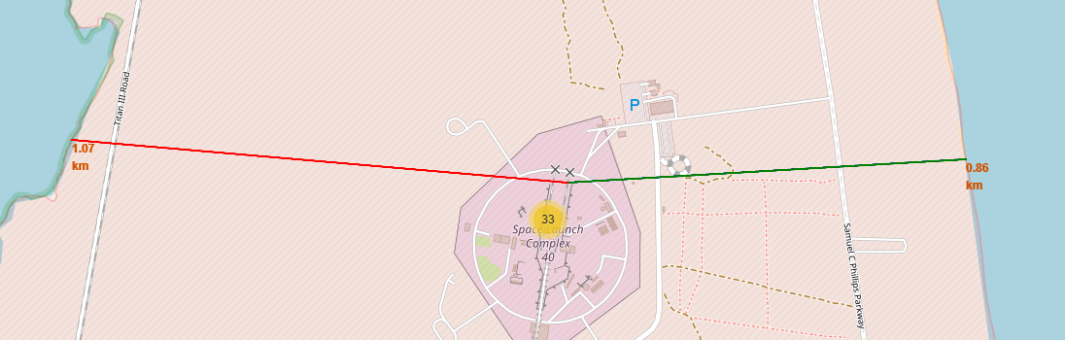
Launch Site Proximity Analysis – Coastline Distances
The folium map displays Launch Complex 40 (SLC-40) with lines pointing to the nearest coastal access points:
East Coast (green line)
West Coast (red line)
Key Elements:
Two labeled lines connecting the launch site to:
The Atlantic coastline to the east (0.86 km)
The inland coastal boundary to the west (1.07 km)
Color-coded markers and distances aid visual comparison.
Insights:
The launch site is closer to the eastern coastline, a strategic advantage for eastward launches over the ocean.
The measured distances help assess potential risk zones and logistic paths for transport or recovery.
Interpretation:
Including these proximity measures supports operational planning for launch logistics, safety buffers, and recovery strategies, especially in coastal launch facilities like SLC-40.

Slide 45

Section 4

Slide 46
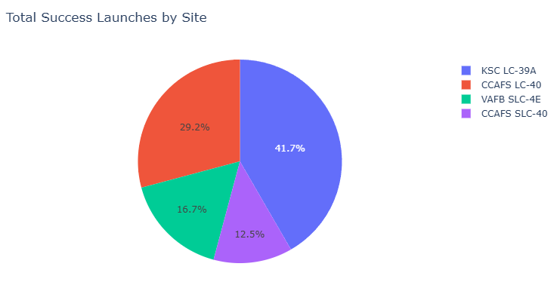
Launch Success Distribution Across All Sites
This pie chart displays the proportion of successful launches per launch site. It reveals that:
KSC LC-39A leads with 41.7% of total successful launches.
Followed by CCAFS LC-40 with 29.2%.
VAFB SLC-4E and CCAFS SLC-40 contribute 16.7% and 12.5%, respectively.
These proportions highlight the relative operational success across sites and indicate that KSC LC-39A is both highly active and reliable.

Slide 47
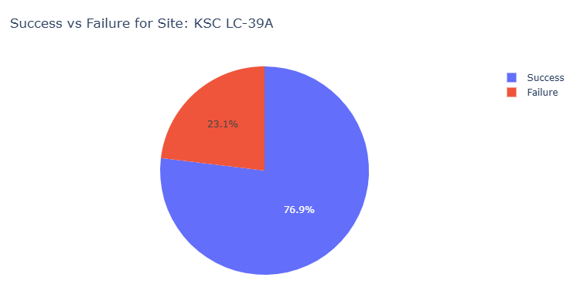
Highest Launch Success Rate: KSC LC-39A
This pie chart shows the launch success distribution for the Kennedy Space Center Launch Complex 39A (KSC LC-39A). With a success rate of approximately 76.9%, it is the highest among all launch sites in the dataset.
The chart highlights:
A dominant share of successful missions (blue).
A smaller proportion of failures (red), indicating a high mission reliability.
Useful insight for identifying optimal launch sites in terms of performance.

Slide 48
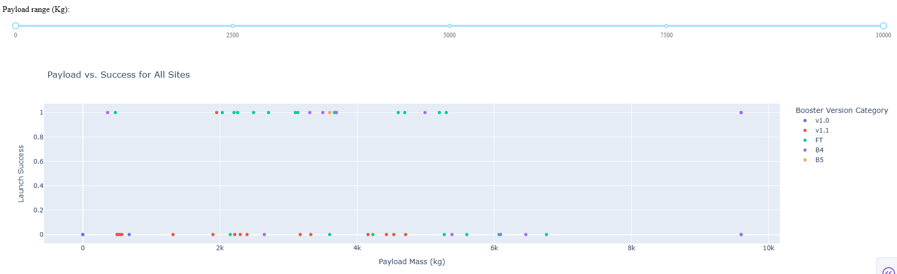
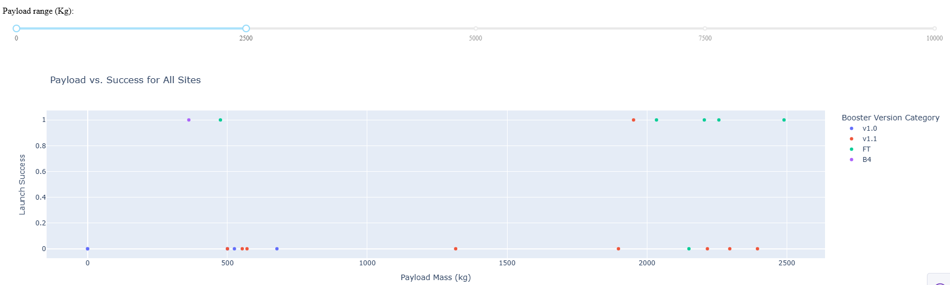
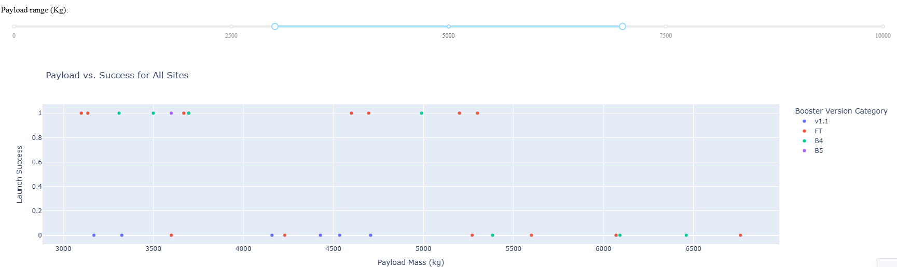
Payload Mass vs. Launch Outcome Across Ranges
Insights:
Shows all launch outcomes across the full payload mass spectrum (0–10,000 kg).
Booster versions B4, B5, and FT demonstrate strong success performance (class = 1).
FT boosters appear the most consistent in achieving successful launches across different payloads.
Insights:
This range shows a high frequency of failures, especially for v1.0 and v1.1 boosters.
Only a few successful launches observed in this low-payload range.
Conclusion:
Lower payload mass does not necessarily lead to higher success.
Booster version appears to be a more critical factor than payload weight in early flights.
Insights:
This range shows a high density of successful launches, particularly with FT, B4, and B5 boosters.
Successful launches are more concentrated in the 3000–6000 kg range.
Conclusion:
Medium payloads (3000–6000 kg) combined with newer boosters yield the highest success rates.
Booster innovation over time has contributed to improved mission outcomes.

Slide 49

Section 5

Slide 50
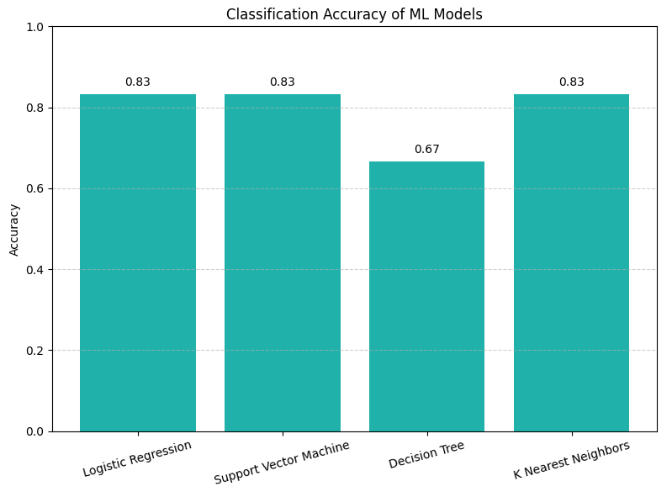
Classification Accuracy
Objective:
Compare the performance of all trained classifiers.
Visualization:
Bar chart showing the accuracy scores of:
Logistic Regression
SVM
Decision Tree
K-Nearest Neighbors (KNN)
Insight:
While Logistic Regression, SVM, and KNN all achieved an accuracy of 0.83, the model with the highest accuracy returned by the selection logic was Logistic Regression. This suggests that Logistic Regression was the most robust choice among the evaluated models for this classification task. The Decision Tree performed notably worse with an accuracy of 0.67.

Slide 51
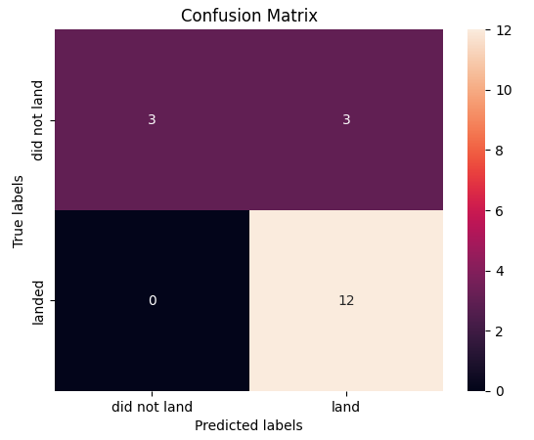
Confusion Matrix
Objective:
Evaluate the classification performance of the best model, Logistic Regression, by visualizing its confusion matrix.
Visualization:
The confusion matrix summarizes the model’s predictions on the test set:
True Positive (TP): 12 — correctly predicted landings
False Positive (FP): 3 — predicted landing, but did not land
True Negative (TN): 3 — correctly predicted failures to land
False Negative (FN): 0 — no landings missed by the model
Insight:
Logistic Regression shows strong predictive performance with:
High recall for the 'landed' class (no false negatives)
Some false positives, indicating occasional overprediction of landings
Balanced classification capability, with the main issue being limited false alarms
Interpretation:
The model effectively distinguishes between successful and unsuccessful landings. Its perfect recall and balanced accuracy (0.833) justify its selection as the top performer.

Slide 52
Conclusions
Launch Success Improved Over Time SpaceX has significantly increased its launch success rate since 2013, reaching over 85% by 2020, indicating continuous operational improvement.
Payload Mass and Launch Site Are Related to Success Missions with heavier payloads tend to have higher success rates when launched from KSC LC-39A and CCAFS SLC-40, suggesting these are better equipped for complex missions.
Orbit Type Influences Success Orbits like LEO, ISS, and SSO show higher success rates than GTO, possibly due to differing technical and risk profiles.
Flight Number Matters in Certain Orbits In the LEO orbit, a higher flight number (i.e., more experience) correlates with higher success, emphasizing learning effects and system reliability.
Proximity to Infrastructure is Strategic Launch sites are typically located close to coastlines, roads, and railways, showing clear logistical planning in SpaceX’s infrastructure decisions.
Logistic Regression Is a Strong Predictor Among the ML models tested, Logistic Regression achieved the best predictive performance (83.3% accuracy) for mission success, proving effective in this binary classification task.
Data-Driven Decisions Are Feasible The project demonstrated that success probability can be reasonably predicted from structured mission data, supporting future mission planning or resource allocation.

Slide 53
Appendix
Python Libraries:
pandas, numpy, matplotlib, seaborn – for data wrangling and plotting
folium – for interactive geographic maps
plotly, dash – for interactive dashboards
sklearn – for building and evaluating ML models
sqlite3, sqlalchemy – for SQL-based analysis
Visualization Types:
Scatter plots, bar charts, line charts
Interactive maps with markers, polylines, and popups
Confusion matrix and model accuracy comparison chart
Other Tools:
GitHub – project version control and code sharing
Jupyter Notebooks – interactive coding and visualization
PowerPoint – final project storytelling

Slide 54


